Slide 1
Errors

Slide 2
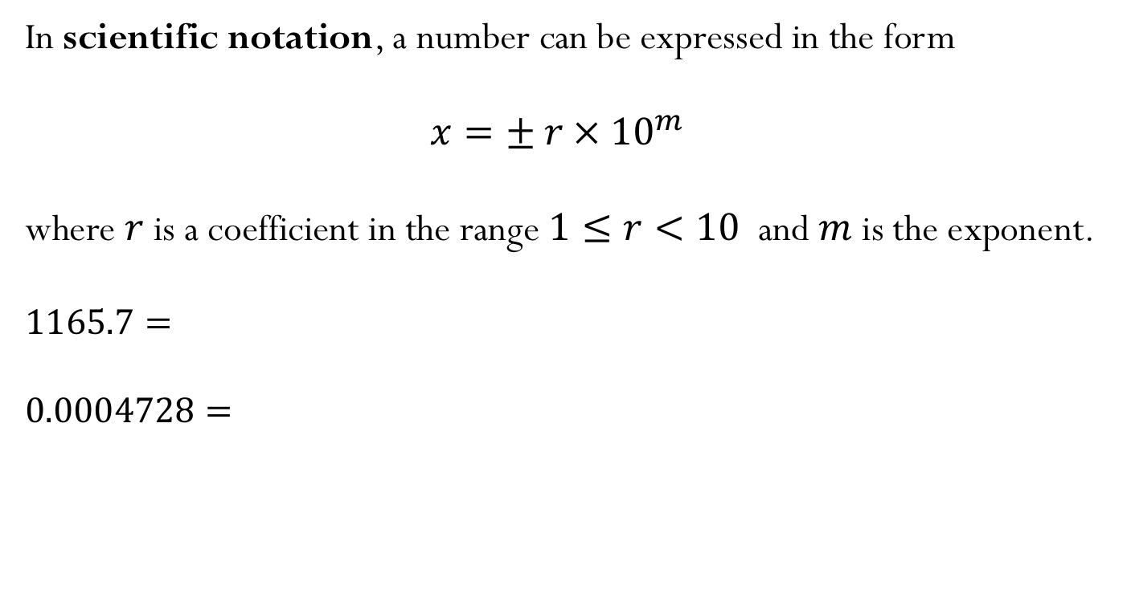
Scientific Notation
In scientific notation, a number can be expressed in the form
$$x=± r ×{ 10}^{m}$$
where $r$is a coefficient in the range $1≤r<10$ and $m$ is the exponent.
$$1165.7=$$
$$0.0004728=$$

Slide 3
Binary numbers
We will soon be learning about how numbers are represented in the computer.
Before we introduce this new concept, make sure to revise binary number representation. You will need to know how to convert form binary numbers to decimal numbers and vice-versa.
To help you with the review, I added a PrairieLearn homework assignment, where you can get extra credit points (counting towards the “short questions”).

Slide 4
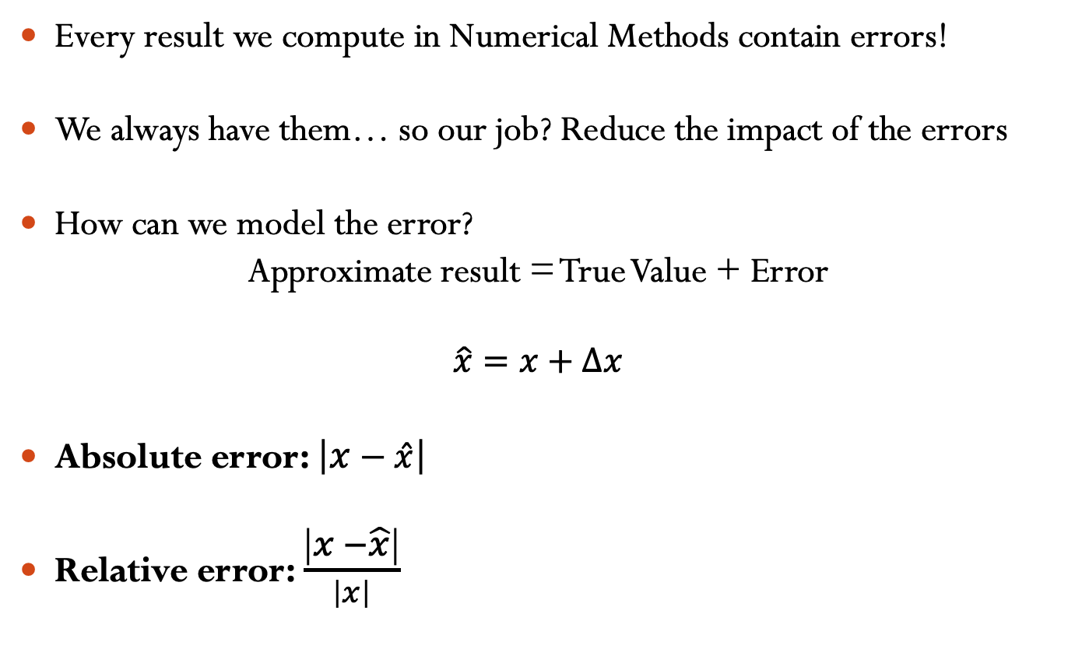
Error in Numerical Methods
Every result we compute in Numerical Methods contain errors!
We always have them… so our job? Reduce the impact of the errors
How can we model the error?
Approximate result = True Value + Error
$$\hat{x}=x+∆x$$
Absolute error: $\left|x−\hat{x}\right|$
Relative error: $\frac{\left|x −\hat{x}\right|}{\left|x\right|}$

Slide 5
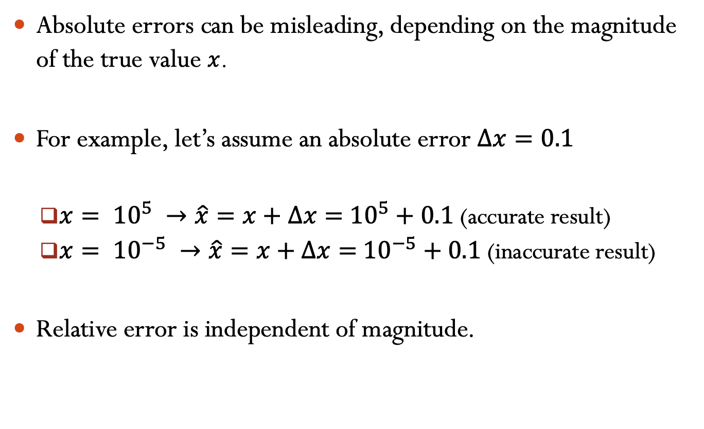
Absolute errors can be misleading, depending on the magnitude of the true value $x$.
For example, let’s assume an absolute error $∆x=0.1$
$x= {10}^{5} →\hat{x}=x+∆x=$ ${10}^{5}+0.1$ (accurate result)
$x= {10}^{−5} →\hat{x}=x+∆x=$ ${10}^{−5}+0.1$ (inaccurate result)
Relative error is independent of magnitude.

Slide 6
You are tasked with measuring the height of a tree which is known to be exactly 170 ft tall. You later realized that your measurement tools are somewhat faulty, up to a relative error of 10%. What is the maximum measurement for the tree height (numbers rounded to 3 sig figs)?
153 ft
155 ft
C) 187 ft
D) 189 ft
Notes:
Talk about why |xo| - |xbar| is not a good way of measuring error.
Answer is 187 (C

Slide 7
You are tasked with measuring the height of a tree and you get the measurement as 170 ft tall. You later realized that your measurement tools are somewhat faulty, up to a relative error of 10%. What is the minimum height of the tree (numbers rounded to 3 sig figs) ?
153 ft
155 ft
C) 187 ft
D) 189 ft
Notes:
Answer is 155 (B)

Slide 8
Significant digits
Significant figures of a number are digits that carry meaningful information. They are digits beginning to the leftmost nonzero digit and ending with the rightmost “correct” digit, including final zeros that are exact.
The number 3.14159 has _____ significant digits.
The number 0.00035 has _____ significant digits.
The number 0.000350 has ______ significant digits.

Slide 9
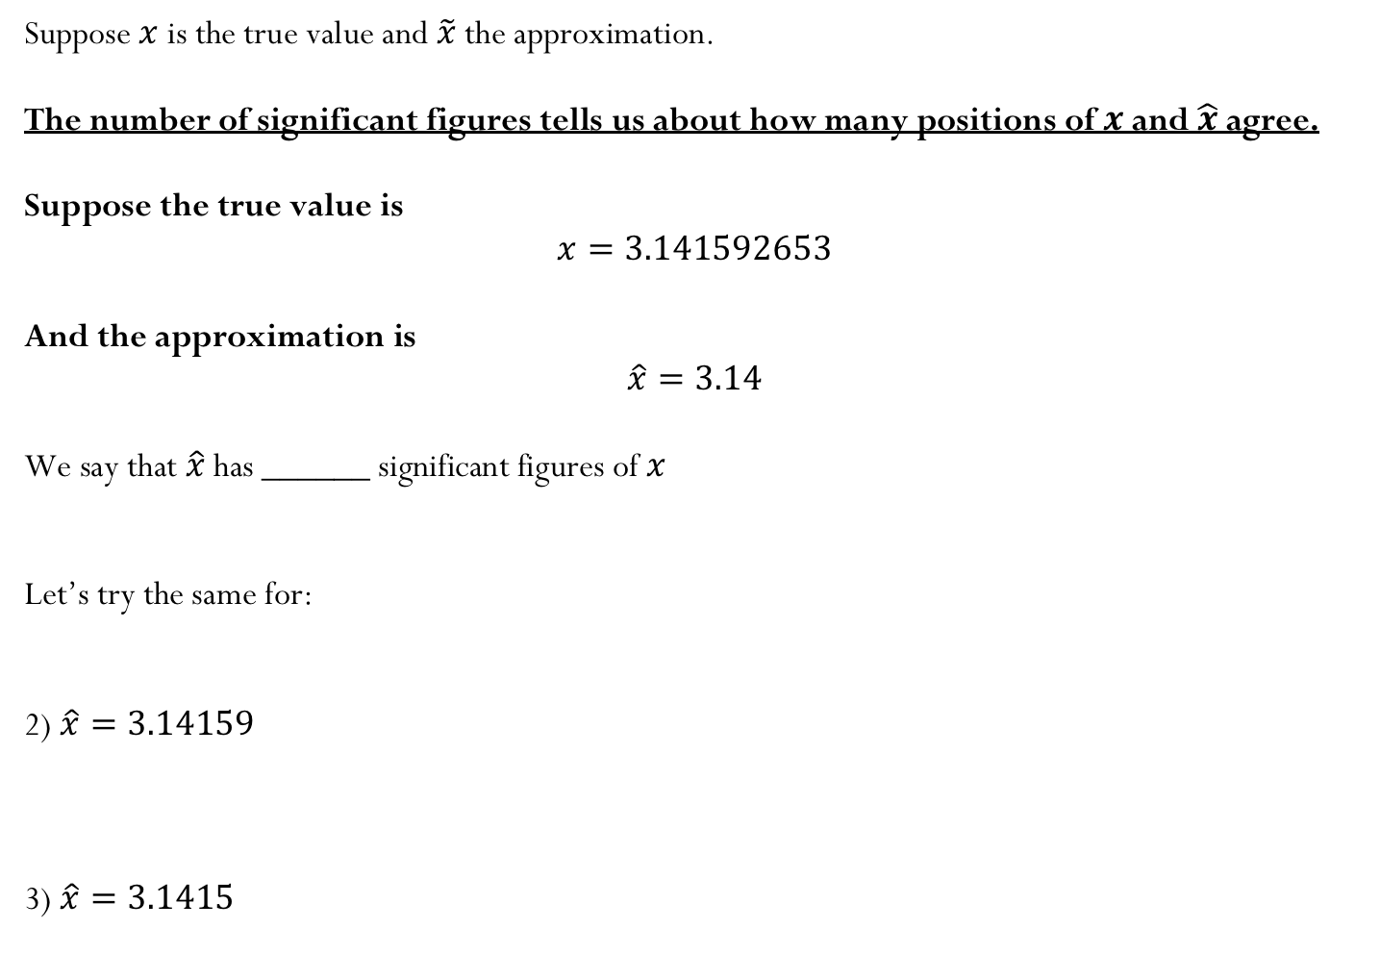
Suppose $x$ is the true value and $\tilde{x}$ the approximation.
The number of significant figures tells us about how many positions of $x$ and $\hat{x}$agree.
Suppose the true value is
$$x=3.141592653$$
And the approximation is
$$\hat{x}=3.14$$
We say that $\hat{x}$ has ______ significant figures of $x$
Let’s try the same for:
2) $\hat{x}=3.14159$
3) $\hat{x}=3.1415$

Slide 10
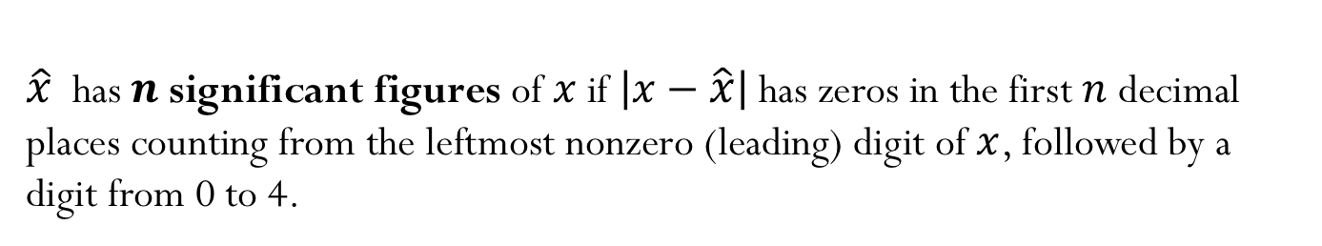
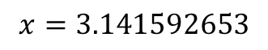
$\hat{x}$ has $n$ significant figures of $x$if $\left|x−\hat{x}\right|$has zeros in the first $n$ decimal places counting from the leftmost nonzero (leading) digit of $x$, followed by a digit from 0 to 4.
$$x=3.141592653$$
$\hat{x} =3.14159⟶\left|x−\hat{x}\right|=0.000002653=2.653×{10}^{−6}⟶\hat{x}$ has 6 sf
6 zeros
$\hat{x}=3.1415⟶\left|x−\hat{x}\right|=0.000092653=0.92653×{10}^{−4}⟶\hat{x}$ has 4 sf
5 zeros
$\hat{x}=3.1416⟶\left|x−\hat{x}\right|=0.000007347=0.7347×{10}^{−5}⟶\hat{x}$ has 5 sf
6 zeros

Slide 11
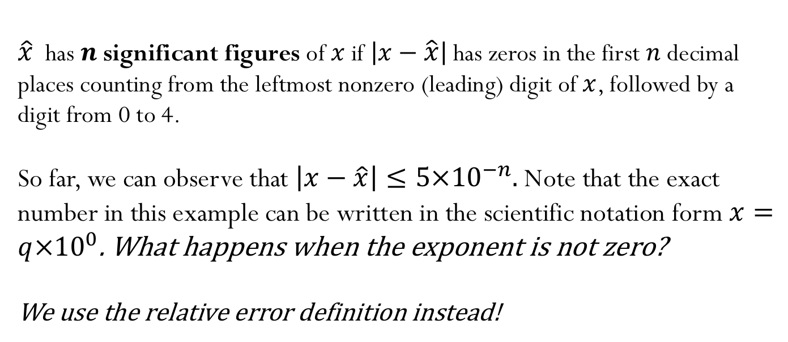
$\hat{x}$ has $n$ significant figures of $x$if $\left|x−\hat{x}\right|$has zeros in the first $n$ decimal places counting from the leftmost nonzero (leading) digit of $x$, followed by a digit from 0 to 4.
So far, we can observe that $\left|x−\hat{x}\right|≤5×{10}^{−n}.$ Note that the exact number in this example can be written in the scientific notation form $x=q×{10}^{0}$. What happens when the exponent is not zero?
We use the relative error definition instead!
$e_{r}=\frac{\left|x−\hat{x}\right|}{\left|x\right|}=$ $\frac{\left|x−\hat{x}\right|}{q×{10}^{m}}$ $≤\frac{5×{10}^{−n}{10}^{m}}{q×{10}^{m}}=\frac{5}{q}×{10}^{−n}$ $≤5×{10}^{−n}$

Slide 12
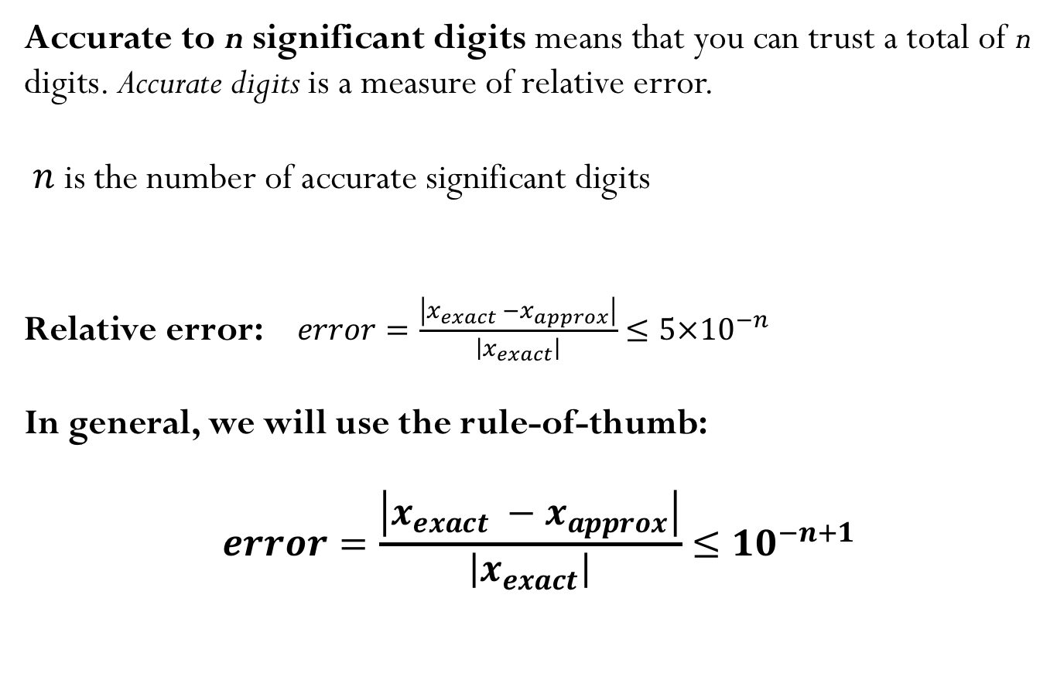
Accurate to n significant digits means that you can trust a total of n digits. Accurate digits is a measure of relative error.
$n$ is the number of accurate significant digits
Relative error: $error=\frac{\left|x_{exact} −x_{approx}\right|}{\left|x_{exact}\right|}≤5×{10}^{−n}$
In general, we will use the rule-of-thumb:
$$error=\frac{\left|x_{exact} −x_{approx}\right|}{\left|x_{exact}\right|}≤{10}^{−n+1}$$
For example, if relative error is ${10}^{−2}$ then $\hat{x}$has at most 3 significant figures of $x$

Slide 13
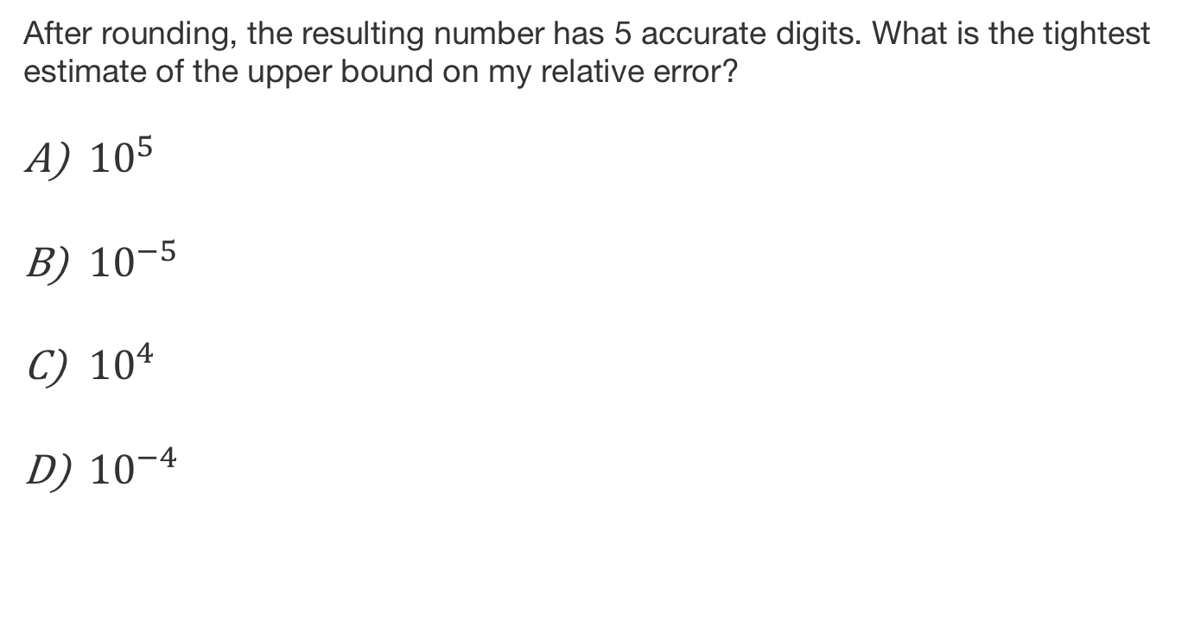
After rounding, the resulting number has 5 accurate digits. What is the tightest estimate of the upper bound on my relative error?
${10}^{5}$
${10}^{−5}$
${10}^{4}$
${10}^{−4}$

Slide 14
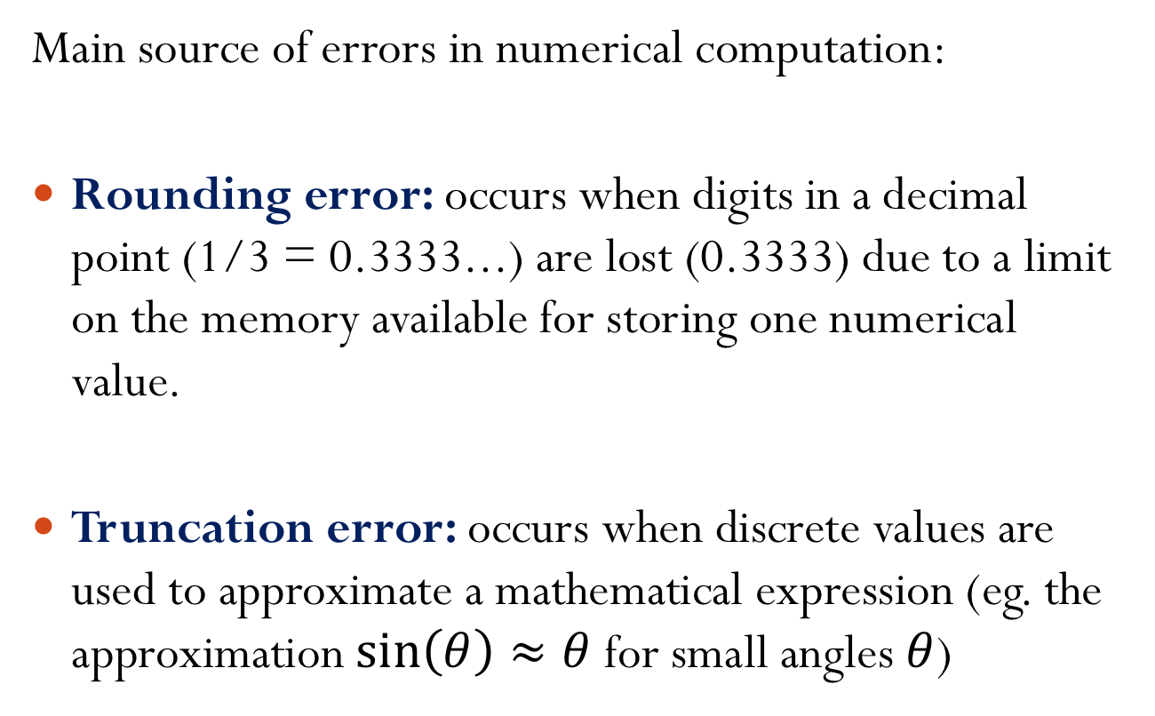
Sources of Error
Main source of errors in numerical computation:
Rounding error: occurs when digits in a decimal point (1/3 = 0.3333...) are lost (0.3333) due to a limit on the memory available for storing one numerical value.
Truncation error: occurs when discrete values are used to approximate a mathematical expression (eg. the approximation $\sin\left(θ\right)≈θ$ for small angles $θ$)

Slide 15
Let’s first talk about plots…

Slide 16
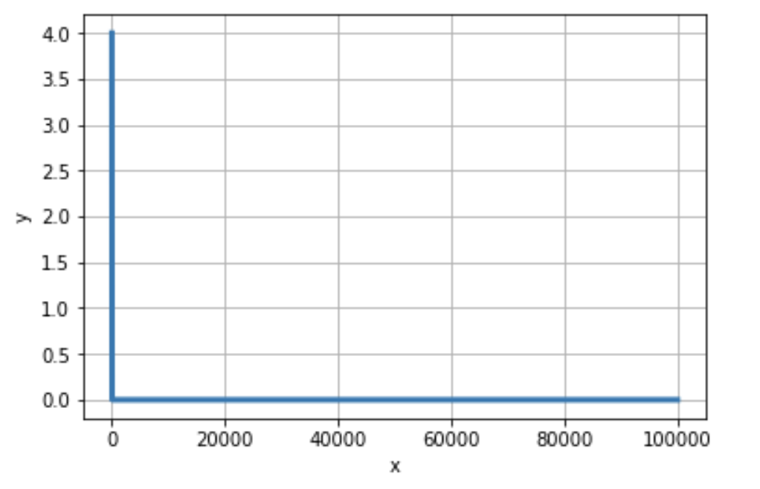
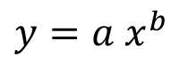
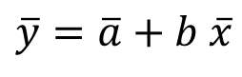
Power functions:
$$y={a x}^{b }$$
$$\log{y}=\log\left({a x}^{b}\right)=\log\left(a\right)+\log\left({ x}^{b}\right)=\log\left(a\right)+b log\left(x\right)$$
$$\overline{y}=\overline{a}+b \overline{x}$$

Slide 17
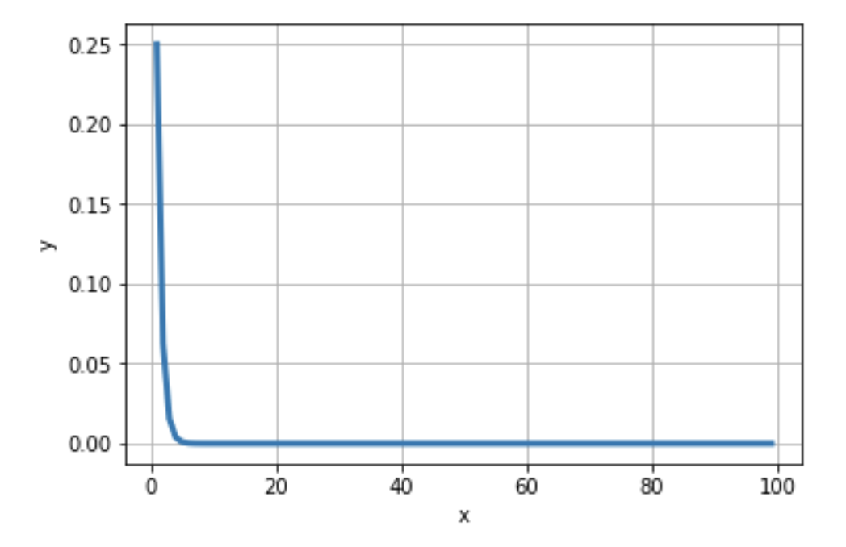
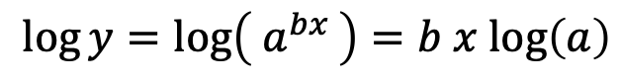
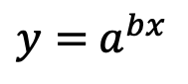
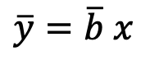
Exponential functions:
$$y={ a}^{bx }$$
$$\log{y}=\log\left({ a}^{bx }\right)=b x log\left(a\right)$$
$$\overline{y}=\overline{b} x$$

Slide 18
Big-O notation

Slide 19
Complexity: Matrix-matrix multiplication
For a matrix with dimensions $n × n$, the computational complexity can be represented by a power function:
$$time={c n}^{a }$$
We could count the total number of operations to determine the value of the constants above, but instead, we will get an estimate using a numerical experiment where we perform several matrix-matrix multiplications for vary matrix sizes, and store the time to take to perform the operation.

Slide 20
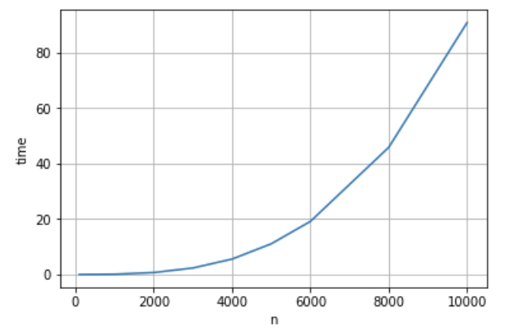
For a matrix with dimensions $n × n$, the computational complexity can be represented by a power function:
$$time={c n}^{a }$$
What type of plot will result in a straight line?
semilog-x B) semilog-y C)log-log

Slide 21
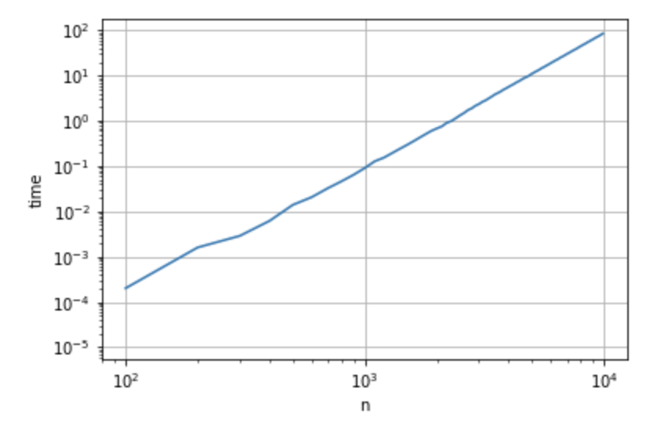
Power functions are represented by straight lines in a log-log plot, where the coefficient $a$ is determined by the slope of the line.
$$time={c n}^{a }$$
Demo: Cost of Matrix-Matrix Multiplication

Slide 22
Instead of predicting time using $time={c n}^{a }$, we can use the big-O notation to write
$$time={O(n}^{a })$$
where $a$ can be obtained from the slope of the straight line.
For a matrix-matrix multiplication, what is the value of $a$?
Demo: Cost of Matrix-Matrix Multiplication

Slide 23
As we mentioned previously, we can also get the complexity by counting the number of operations needed to perform the computation:

Slide 24
Big-Oh notation
Let $f$and $g$ be two functions. Then
$f\left(x\right)=O\left(g\left(x\right)\right)$ as $x→∞$
If an only if there is a positive constant M such that for all sufficiently large values of $x$, the absolute value of $f\left(x\right)$ is at most multiplied by the absolute value of $g\left(x\right)$. In other words, there exists a value $M$and some $x_{0}$such that:
$$\left|f\left(x\right)\right|≤M \left|g\left(x\right)\right| ∀ x≥x_{0}$$
Notes:
if and only if there is a positive constant M such that for all sufficiently large values of x, the absolute value of f(x) is at most Mmultiplied by the absolute value of g(x).

Slide 25
Example:
Consider the function $f\left(x\right)=2x^{2}+27x+1000$
When $x→∞$, the term $x^{2}$ is the most significant, and hence,
$$f\left(x\right)=O(x^{2})$$

Slide 26
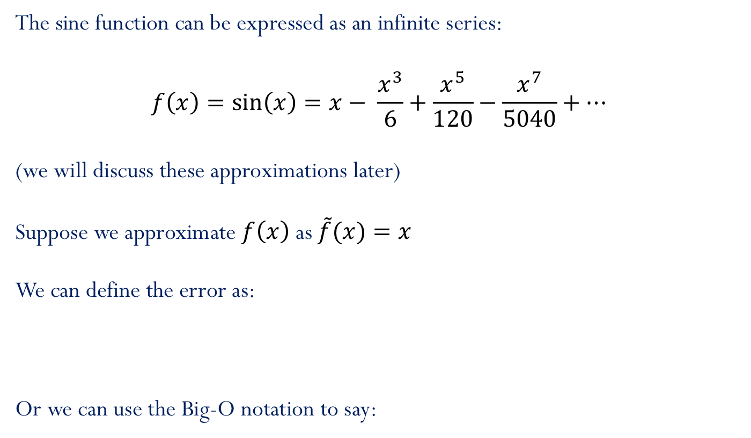
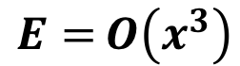
Accuracy: approximating sine function
The sine function can be expressed as an infinite series:
$$f\left(x\right)=\sin\left(x\right)=x− \frac{x^{3}}{6}+\frac{x^{5}}{120}−\frac{x^{7}}{5040}+…$$
(we will discuss these approximations later)
Suppose we approximate $f\left(x\right)$ as $\tilde{f}(x){=x}$
We can define the error as:
Or we can use the Big-O notation to say:
$$E=\left|f\left(x\right)−\tilde{f}(x)\right|=\left|−\frac{x^{3}}{6}+\frac{x^{5}}{120}−\frac{x^{7}}{5040}+…\right|$$
$$E={O\left(x^{3}\right)}$$

Slide 27
Big-Oh notation (continue)
Let $f$and $g$ be two functions. Then
$f\left(x\right)=O\left(g\left(x\right)\right)$ as $x→a$
If an only if there exists a value $M$and some $δ$ such that:
$$\left|f\left(x\right)\right|≤M \left|g\left(x\right)\right| ∀x where 0<|x−a|<δ$$

Slide 28
Same example…
Consider the function $f\left(x\right)=2x^{2}+27x+1000$
When $x→0$, the constant 1000 is the dominant part of the function. Hence,
$$f\left(x\right)=O(1)$$

Slide 29
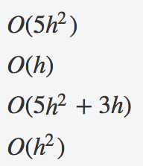
Iclicker question
Suppose that the truncation error of a numerical method is given by the following function:
$$E\left(h\right)=5h^{2}+3h$$
Which of the following functions are Oh-estimates of $E\left(h\right)$ as $h→0$
Mark the correct answer:
A) 1 and 2
B) 2 and 3
C) 2 and 4
D) 3 and 4
E) NOTA
1)
2)
3)
4)

Slide 30
Iclicker question
Suppose that the complexity of a numerical method is given by the following function:
$$c\left(n\right)=5n^{2}+3n$$
Which of the following functions are Oh-estimates of $c\left(n\right)$ as $n→∞$
1)$O(5n^{2}+3n)$
2) $O(n^{2})$
3) $O(n^{3})$
4) $O(n)$
Mark the correct answer:
A) 1,2,3
B) 1,2,3,4
C) 4
D) 3
E) NOTA

Slide 31
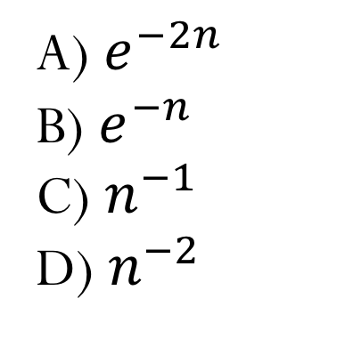
Select the function that best represents the decay of the error as $n$ increases
A) $e^{−2n}$
B) $e^{−n}$
C) $n^{−1}$
D) $n^{−2}$

Slide 32
Rates of convergence
$$error\sim \frac{1}{n^{α}}$$
or$O\left(\frac{1}{n^{α}}\right)$
1) Algebraic convergence:
Algebraic growth:
$$time\sim n^{α}$$
or$O\left(n^{α}\right)$
$α:$ Algebraic index of convergence
A sequence that grows or converges algebraically is a straight line in a log-log plot.
Demo “Exponential, Algebraic and Geometric convergence”

Slide 33
Rates of convergence
2) Exponential convergence:
$$error\sim e^{−αn}$$
or$O\left(e^{−αn}\right)$
Exponential growth:
$$time\sim e^{αn}$$
or$O\left(e^{αn}\right)$
A sequence that grows or converges exponentially is a straight line in a linear-log plot.

Slide 34
Rates of convergence
Exponential growth/convergence is much faster than algebraic growth/convergence.

